Slide 1
MATP Time Study Manual for Time Study Coordinators and Participants November 2016

Slide 2
Timeline and factors which lead to the changes…
The Code of Federal Regulations, specifically 2 CFR 200 (previously Circular A-87), contains standards and principles for determining direct and indirect costs applicable to Federal
grants and contracts performed by state and local governments
Centers for Medicare & Medicaid Services (CMS) expressed concern on the accuracy of expenditures applicable to Medicaid
CMS requires updates to existing cost allocation processes to refine the measurement of MATP administrative activities. The current cost allocation plan did not provide
sufficient evidence to differentiate direct vs. indirect costs
CMS conducted a review of the MATP cost allocation process
2012
2013
2014
2015
Present
Submit cost allocation plan
to CMS
Submit revised cost allocation
plan to CMS
Review CMS guidance and conduct research
Develop and present time
study options
Negotiate changes with CMS
Implement
time study
roll-out plan
(Go-Live ’15/’16)
Notes:
Speaker Notes:
Why is a new time reporting process needed?
Centers for Medicare and Medicare Services (CMS) conducted a review of the MATP process and as a result, expressed concern on the accuracy of our time reporting process.
There are also federal regulations defined in the Code of Federal Regulations….previously in a Circular A-87….that contains standards and principles for determining direct and indirect costs applicable to Federal grants and contracts performed by state and local governments.
As a result of CMS review and federal regulations brings requests for time reporting changes.
On the lower half of this slide shows a graphic of a timeline that bring us to the present day.

Slide 3
Identifying Allowable Agency Direct Costs Methods
Category | Description | Allowable Activities | Allowable Methods
Salaries & Benefits | Employee MATP salary and benefits (wages, benefits, related miscellaneous costs) | Preparing MATP reports; Recipient verification; Referral to services; Case management; Negotiating and monitoring contracts; Process reimbursement checks; Quality assurance; Invoicing; Completing application forms; Staffing call center; Servicing clients; Program supervision; Program management; On-the-job training; Responding to audit; Program meetings; Budget monitoring | MATP approved time study methodology
Rent/Lease of Space | County agency MATP rent, utilities, insurance, telephone and related miscellaneous expenses | Office space; Call center; Office phones; Cell phones | Rent/utilities/insurance – MATP square footage as % of total square footage Telephone usage by MATP staff as % of total usage or direct charge Call Center and Program Operations staff if telephone bill discretely identifies line charges
Materials and Supplies | County agency MATP materials, printing, copying, office supplies expenses and postage | Office supplies; Program brochures; Document copying; Mailings | Direct charge to MATP
Office Furniture and Equipment | County agency MATP office furniture and equipment expenses | For MATP program staff | Direct charge to MATP Depreciation Amount
Notes:
Speaker Notes:
This slide and the next slide provides examples of methods for identifying MATP direct and allocated costs for the major headings in the Revised MATP Cost Report.
Instructions for reporting the costs by service model are included in the Instructions tab of each cost report model file. For more details on how to claim each costs by service model structure (Vendor, Service Provider, or Hybrid), refer to the this tab in each report.

Slide 4
Identifying Allowable Agency Direct Costs Methods
Category | Description | Allowable Activities | Allowable Methods
Data Processing | County agency MATP data processing MATP expenses | Computer purchase; Computer LAN support; Software; Report set-up; Report production; IT subcontract support | System usage if statistics available to discretely identify MATP Work orders/invoices Computer and software purchases
Travel | County agency staff MATP travel expenses | DHS meetings; Provider reviews; Program-related conferences and meetings | Direct charge to MATP
Fees | County agency MATP fees expenses | Professional association; Publications; Insurance; Bank charges; Other (requires detail submitted with report) | Direct charge to MATP Statistic used to identify MATP share
Computer Equipment/ Maintenance | County agency MATP computer equipment/maintenance expenses | For Call Center Staff; For MATP Program Staff; For Drivers | Direct charge to MATP Statistic used to identify MATP share
Postage | County agency MATP postage expenses | Mailings; MATP correspondence | Direct charge to MATP Statistic used to identify MATP share
Please refer to the Appendix for a complete list of allowable activities and codes for the Personnel Activity Report
Notes:
Speaker Notes:
This slide provides more examples of methods for identifying MATP direct and allocated costs for the major headings in the Revised MATP Cost Report.
You can refer MATP and Non-MATP activities which is embedded on this slide for a complete list.

Slide 5
Time Study
MATP Time Study
Agency staff will be required to record 100% of their time to MATP and Other Program activities in 15 minute increments during the daily work schedule.
The results of the quarterly time study will be used to allocate direct staff salary to MATP as a percentage of the time working on MATP activities.
The Grantee will assign a time study coordinator to work with DHS to ensure completion and accuracy of time study.
Notes:
Speaker Notes:
The time reporting methodology we will be implementing is called Random Moment Time Study.
What is Random Moment Time Study?
RMS is the most frequently used time reporting method for cost allocation to document and track time for staff working on federal, state, and local programs.
This technique is approved by CMS.
RMS method polls staff at random time intervals over a given time period to track their time on all the activities and programs worked.
RMS has become an industry standard in the Public Sector.
Those were a few facts about RMS.
How are we going to use it for MATP?
MATP time study will be conducted over a random 4 week consecutive period each quarter. The random 4 weeks will be selected by DHS.
The MATP time study will consist of a minimum of 115 employees reporting 100% of their time for the 4 chosen weeks. This will result in a significant time sample of 115 employees and 460 worker weeks.
DHS will randomly select 115 eligible employees from across the state based on the survey previously conducted by DHS.
County staff chosen for the sampling will be required to record their time to MATP and other program activities in 15 minute increments during their daily work schedule.
The results of the time study will be used to allocate direct staff salary to MATP across all grantees selecting this method.
The Grantee will assign a time study coordinator to work with DHS.

Slide 6
Impact to Stakeholders
MATP Time Study Participants
Record time to MATP and other program activities in 15 minute increments during the daily work schedule
Supervisors
Oversee the compliance of participants on a daily basis
MATP Time Study Coordinators
Receive training on the time reporting process
Review and sign time reporting sheets once the time study is complete
Summarize time study results and submit them to DHS
County Financial
Managers
Review and approve the Coordinators’ calculation of direct administrative MATP costs
Manage and oversee the quarterly time study results prior to submission to DHS
County Human Services Directors
Oversee the time study process
Ensure compliance of cost allocation Federal standards
6
Notes:
Speaker Notes:
This slide lays out the 4 stakeholders and impact to each of them.
MATP Participants will use PAR reports to record time to MATP and other program activities in 15 minute increments during the daily work schedule.
Supervisors will oversee the compliance of participants on a daily basis
Coordinators will review and sign time reporting sheets. They will summarize time study results and submit them to DHS.
Financial Managers will review and approve the Coordinators’ calculation of the direct administrative MATP costs. They will also manage and oversee the quarterly time study results prior to submission to DHS.
Human Services Directors will oversee the time study process and ensure compliance of the federal standards

Slide 7
MATP Time Reporting Process
Staff must log 100% of their time
MATP staff participate in Service Provider or Hybrid model counties
100%
15 minute increments

Slide 9
Time Study
A Personnel Activity Report has been developed as the tool for you to use to track your time spent throughout your work day.

Slide 10
It is an Excel based tool to use for tracking time

Slide 11
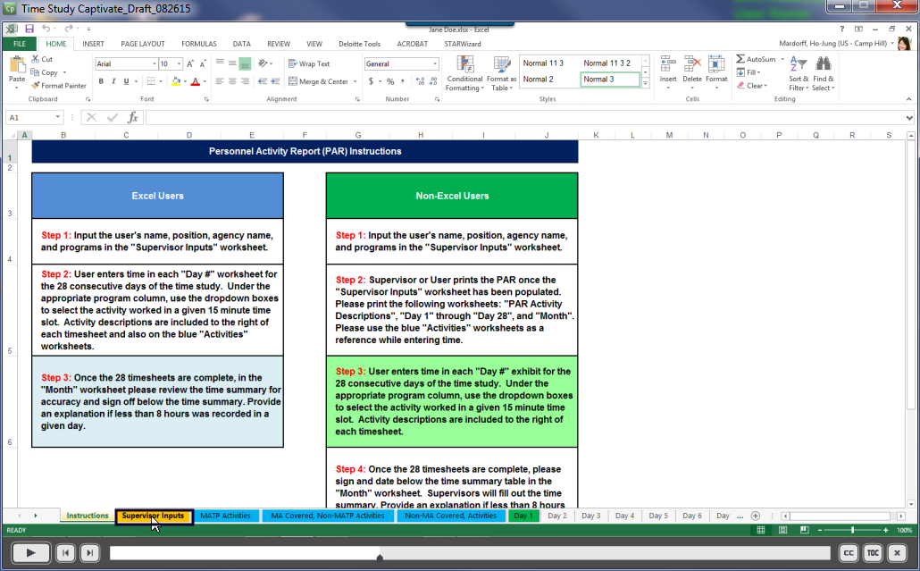
Instructions will be provided in the first tab for both Excel Users and Non-Excel Users. The Personnel Activity Report (PAR) may be completed electronically or printed out and filled in by hand.

Slide 12
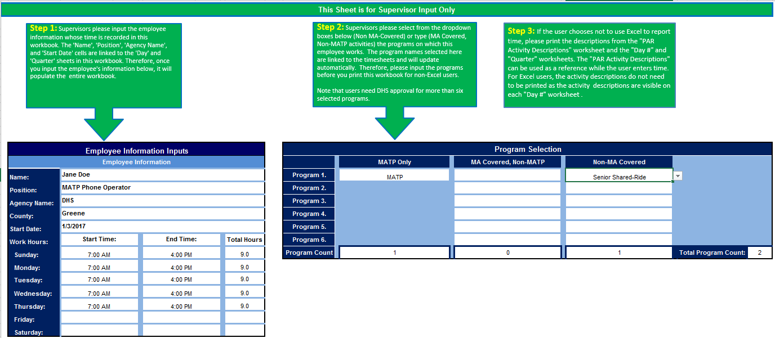
A supervisor will be responsible for completing the program selections for each employee participating in the time study. Step by step instructions are outlined within the document.

Slide 14
Separate tabs are provided within the document, which list all codes for MATP Activities, MA Covered/Non-MATP Activities, and Non-MA/Non-MATP Activities.
A list of all codes for activities is also provided in the appendix of this manual.
The activities below will be coded as A1

Slide 15
Key Questions 1. What program am I supporting? MATP Only, MA Covered, Non MATP, or Non-MA Covered 2. Who I supporting? Recipient, Service Provider, Program Office, or Time Off?
Employees participating in the time study will enter their time with one of the code combinations on the left.
A complete list of codes is provided in the Appendix.

Slide 16
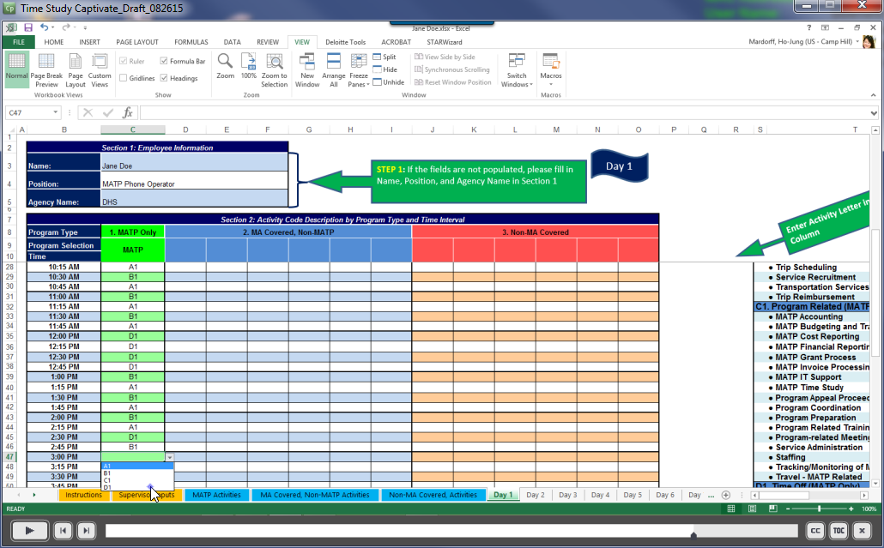
Employees participating in the time study will enter their time in 15 minute increments utilizing the drop box feature (Excel Users) or by entering the code by hand into each block (Non-Excel Users).

Slide 17
A time study training course will be made available for time study coordinators and participants on the MATP website at http://www.MATP.pa.gov.
Course Assessment

Slide 18
Resources
For training materials, please visit the following website:
http://matp.pa.gov/Training.aspx
For any questions or comments on the MATP Time Study implementation, please contact Brian Salett at c-bsalett@pa.gov
Notes:
Speaker Notes:
As new and revised training materials are available for the stakeholders, we will be placing them to the DHS website listed on the slide.
A copy of this presentation will be placed on the website within the next 24 hours.
For any other questions or comments you have that’s not addressed in this presentation or any of the training materials posted, please feel free to contact Mara Perez, DHS’s Financial Management Section Chief of the Bureau of Managed Care Operations at her email address on the slide.

Slide 19
Appendix: Coding for Time Study

Slide 20
Appendix: Coding for Time Study

Slide 21
Appendix: Coding for Time Study

Slide 22
Appendix: Coding for Time Study

Slide 23
Appendix: Coding for Time Study

Slide 24
Appendix: Coding for Time Study

Slide 25
Appendix: Coding for Time Study

Slide 26
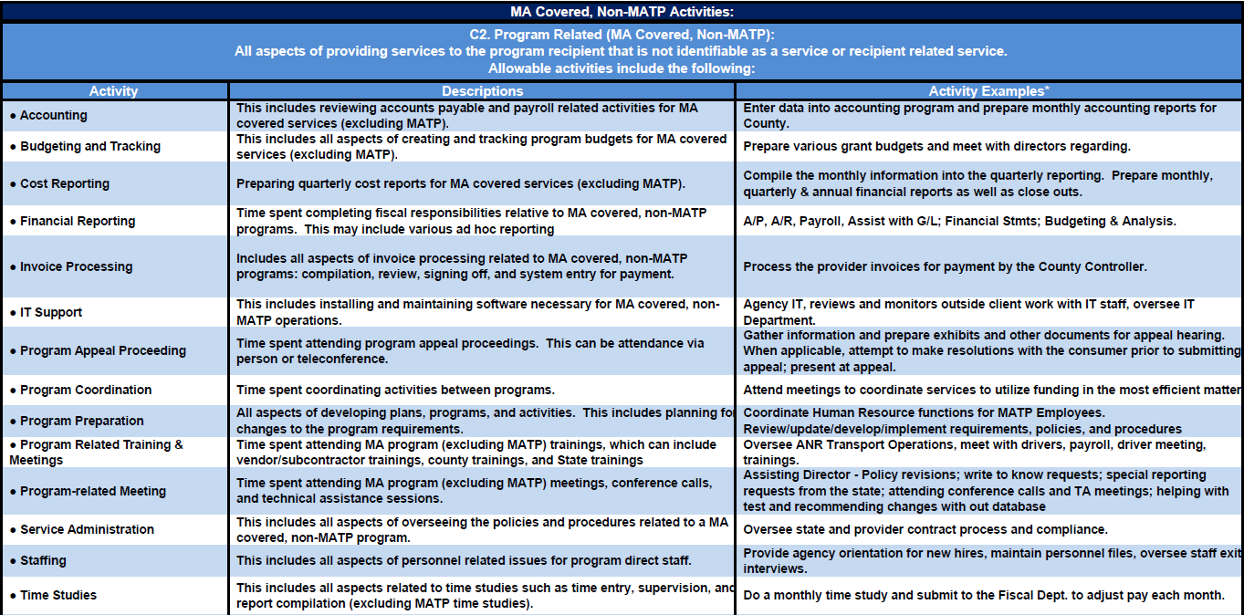
Appendix: Coding for Time Study

Slide 27
Appendix: Coding for Time Study

Slide 28
Appendix: Coding for Time Study

Slide 29
Appendix: Coding for Time Study

Slide 30
Appendix: Coding for Time Study

Slide 31
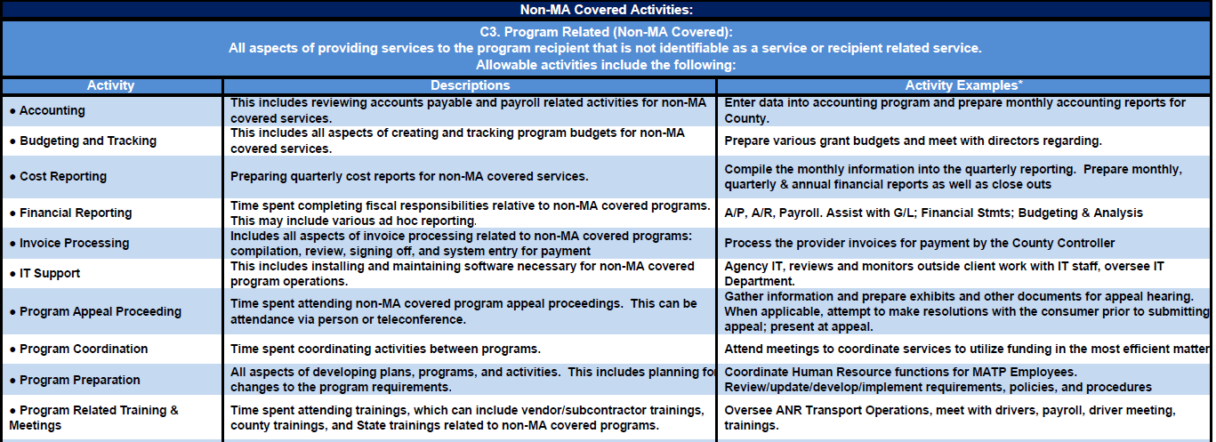
Appendix: Coding for Time Study

Slide 32
Appendix: Coding for Time Study

Slide 33
Appendix: Coding for Time Study

Slide 34
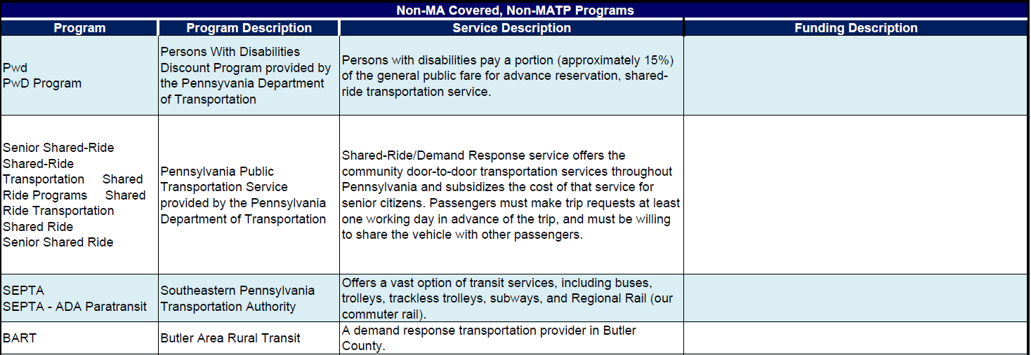
Appendix: Non-MA Covered, Non-MATP Programs

Slide 35
Appendix: Non-MA Covered, Non-MATP Programs

Slide 36
Appendix: Non-MA Covered, Non-MATP Programs

Slide 37
Appendix: Non-MA Covered, Non-MATP Programs

