Slide 1
Medical Assistance Transportation Program (MATP)
MATP BASICS

Slide 2
MATP Basics
The MATP in Pennsylvania is governed by:
State Plan under Title XIX of the Social Security Act
Public Welfare Code (62 P.S. §§ 202 & 403)
55 Pa. Code § 2070, Eligibility for Services Funded Through the Public Assistance Transportation Block Grant
MATP Standards and Guidelines (S & G)

Slide 3
What is MATP?
The MATP is designed to provide:
Access to MA compensable medical and pharmacy services
Access to ongoing treatment of chronic diseases and care management
Access to care with individual medical practices.
Access to preventative care (equates to fewer and shorter hospital stays)

Slide 4
Transportation Providers
County Government
Sub-Contracted Entities of County Government
Transportation Brokerage Agencies
Local Transit Agencies

Slide 5
Available Modes of Transportation
Mass transit (buses, trains, subways etc..)
Mileage Reimbursement
Paratransit (includes multi-modal and taxi)
Volunteers

Slide 6
Accessing MATP Services
To begin the registration process, the consumer should contact the MATP agency in their county in order to determine and complete the following:
Eligibility
75% of all Category/Code combinations are eligible for the MATP
Consumers 65 years of age are referred to the Shared Ride 65+ Program (Shared Ride+ pays 85% of the fare and MATP pays 15% of the fare)
Application
Needs Assessment
Determination of Mode

Slide 7
Find My Ride Apply
The Find My Ride Apply App allows consumers or someone acting on their behalf to apply for free and affordable transportation services for seniors, persons with disabilities, and people who need assistance to get to medical appointments including the MATP, Senior 65+, ADA and PWD programs. The app can be accessed at:
www.apply.findmyride.penndot.pa.gov

Slide 8
Covered Services
MATP is required to provide transportation to all MA compensable services.
MATP must ensure transportation is only to and from qualified MA-enrolled providers of the consumer’s choice which are typically available within their home community.

Slide 9
Covered Services continued
Examples of covered services:
Physician’s Office
Dialysis
Pharmacy
Behavioral Health Outpatient
Methadone Clinic
Physical/Occupational Therapy
Medical Testing
Specialty Medical Treatment

Slide 10
Urgent Care Transportation
MATP provides urgent care medical services (same-day, after normal business hours, and weekend transportation).
Urgent care medical services are defined as any illness or severe condition, which is verified by a medical professional as necessary to diagnose and treat within a 24-hour period and if left untreated, could rapidly become a crisis or emergency.
A hospital discharge can be considered urgent care.

Slide 11
Non-Covered Services
Examples of non-covered services:
Transportation to any service not MA compensable
Transportation to non-medical services
Transportation for those requiring a stretcher or those who are technologically dependent (Ventilators)
Transportation to adult day programs

Slide 12
The Provision of Services
If necessary, one (1) escort is allowed to accompany a consumer due to consumer’s age, physical, mental, and/or developmental capacity.
Depending on the circumstances and known factors, the MATP may provide an attendant on the trip (this generally is provided for grouped children’s transportation).
In order to ensure that services are cost efficient, appropriate, and meet the needs of the consumer, the MATP may request a waiver of a MATP requirement.

Slide 13
The Provision of Services Continued
Any issue brought to the attention of the MATP program by a consumer, guardian, advocate or agency for the purpose of assistance or resolution is considered a “complaint.”
There are times when the MATP program may, deny, reduce or terminate a consumer’s request for transportation.

Slide 14
The Provision of Services Continued
If a transportation request is outside the scope of MATP, the request is referred to the HealthChoices Managed Care Organization, Community HealthChoices Managed Care Organization (CHC), or County Assistance Office (CAO) for consideration.
MATP provides non-emergency medical transportation to CHC consumers, and the application and access procedures are according to individual county policy.

Slide 15
MATP Updates
Updating our Standards & Guidelines.
A revised referral process has been implemented.
We continue to collaborate with PennDOT on efforts to streamline current policies/processes.
MATP participated in PennDOT’s study on funding for human services transportation.

Slide 16
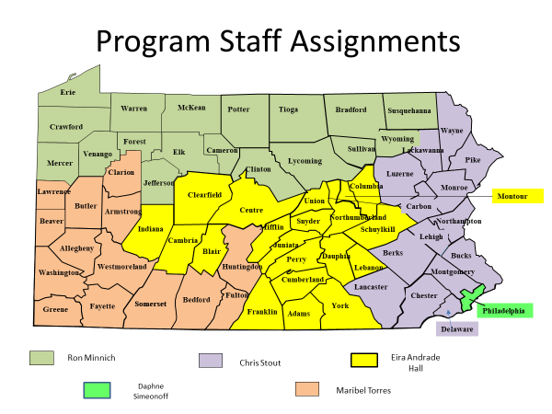
Program Staff Assignments

Slide 17
MATP Staff Directory
Tamara Carter - Director
Telephone: 717-346-3937 Email: tacarter@pa.gov
Daphne Simeonoff – Supervisor/Advisor: Philadelphia
Telephone: 717-265-7829 Email: daphsimeon@pa.gov
Eira Andrade-Hall – Advisor: Adams, Columbia, Cumberland, Franklin, Indiana, Montour, Northumberland, Perry, Snyder, Union, York (Rabbit Transit), Mifflin, Juniata (C.A.R.S), Blair, Cambria, Clearfield, Centre, Dauphin, Lebanon, Schuylkill
Telephone: 717-214-1351 Email: eandradeha@pa.gov
Ronald Minnich – Advisor: Bradford, Tioga, Sullivan (Best Transit), Clinton, Lycoming (STEP), Cameron, Elk, McKean (ATA), Susquehanna, Wyoming (TREHAB), Crawford, Erie, Forest, Jefferson, Mercer, Potter, Venango, Warren
Telephone: 717-705-8259 Email: rominnich@pa.gov
Christopher Stout – Advisor: Carbon, Lehigh, Northampton (LANTa), Berks, Lancaster (SCTA), Bucks, Chester, Delaware, Lackawanna, Luzerne, Montgomery, Monroe, Pike, Philadelphia, Wayne
Telephone: 717-934 4852 Email: chrstout@pa.gov
Maribel Torres – Advisor: Allegheny, Armstrong, Beaver, Bedford, Butler, Clarion, Fayette, Fulton, Greene, Huntingdon, Lawrence, Somerset, Washington, Westmoreland
Telephone: 717-772-6873 Email: martorres@pa.gov
Notes:
This is the contact list for the DHS MATP staff.

Slide 18
Thank you!
For more information, please visit www.matp.pa.gov

